Slide 1
SharePoint 2010:
Architectural Changes
- Headlines
More Scalable
More Flexible
More Features

Slide 2
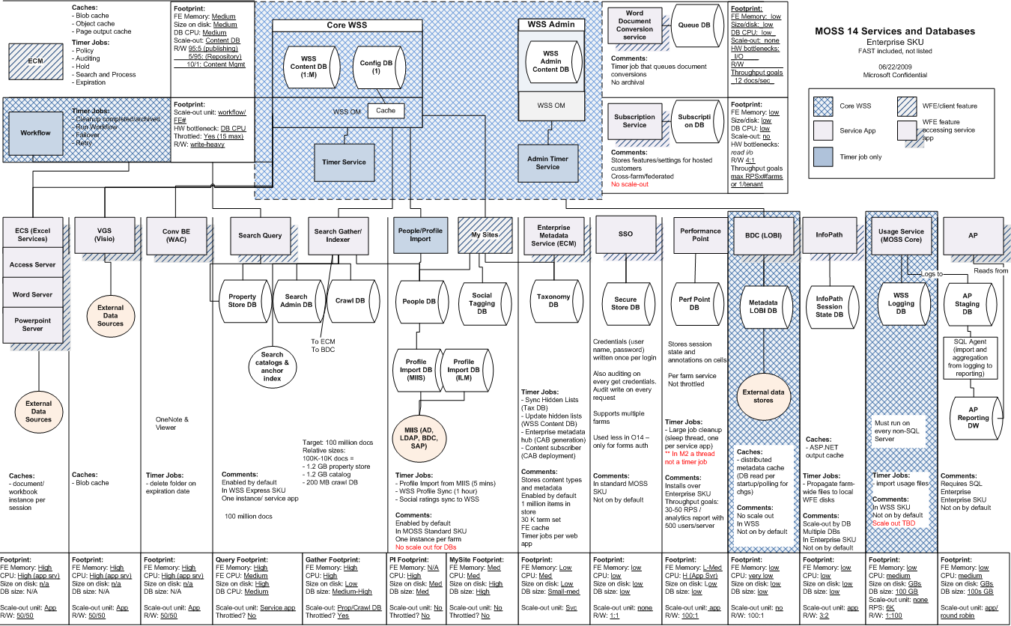
SharePoint 2010 Architectural Schematic

Slide 3
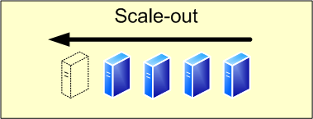
SharePoint 2010 Architecture
More Scalable
Significant work invested in
SQL (to eliminate locks, etc.)
New Service model and Timer job affinity allows server “grouping”
Extensive performance and reliability testing
Highly scalable Search Architecture

Slide 4
SharePoint 2010 Architecture
More Flexible
Server number can now be much larger
(Tens of servers in a single farm)
Enterprises can write their own services that take advantage of the SharePoint infrastructure
PTC (Partially Trusted Code) hosting
PowerShell scripting replacing STSADM

Slide 5
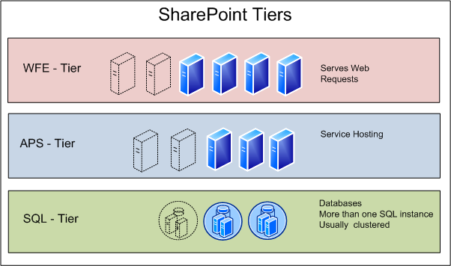
SharePoint 2010 Architecture
Tiers
WFE Tiers – Some changes, some optimization
App. Server Tiers – Many changes
SQL Tiers – Some changes, heavy optimization

Slide 6
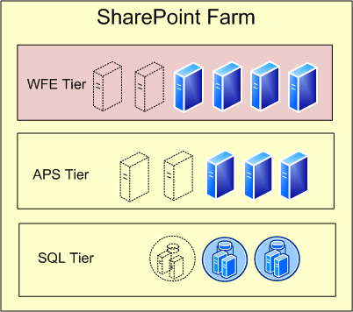
SharePoint 2010 Architecture
Web-Front-End Servers – Highlights
Ribbon UI
Claims-based identity
Throttling features to handle peaks gracefully
Memory Optimization => less memory issues
New Usage Logging API
Caching improvements

Slide 7
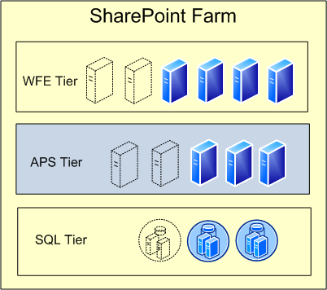
SharePoint 2010 Architecture
Application Server Services
List of services that can run on Application Servers:
  Native
    Access
    BDC
    Excel Services
    Performance Point
    Visio Services
    Word
    PPT
    Office Web Applications
    Project Server
    More will come…
  Custom Applications

Slide 8
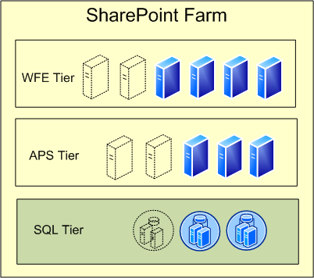
SharePoint 2010 Architecture
SQL Tier Changes
Many more Databases to manage
Granular Database Structure
  ‘Service Application’ Database is split up =>many new features have their own Database
Partial List of services with own database:
  Search
  People / Profile Import
  Tagging
  Taxonomy
  InfoPath (session state)
  Secure Store
  LOBi
  Web Analytics
  Performance Point

Slide 9
SharePoint 2010 Architecture
Farm-Level Changes
Service Model - Paradigm Change: SSPs are no more!
  Reasoning:
    Unusual concept
    Hard to deploy and manage
    Unable to scale: too many services in one database
New concept is “Service Application” or “Service App”
  Shared services split out into separate services
    Profiles, Audiences => People Service App
    Search => Search Service App
    Excel => Excel Service App
    BDC => BCS Service App
There are also many other new Service Applications
Service Applications can be ‘Cross-Farm’ instead of
‘Parent-Child Farm’

Slide 10
SharePoint 2010 Architecture
Improvements
Lower Latency & Increased Throughput
Native support for IIS7
  No longer run in IIS compatibility mode
  Increased throughput across the platform
Refactored Initial Payload
  Script and UI Images (Probably – we’re still in Beta ☺ )
Post-backs cut in many places
  Substantial use of AJAX in the UI
Significant developer focus on:
  TTFB, TTLB & SQL Round Trips

Slide 11
SharePoint 2010 Architecture
Other SQL Changes
Snapshot management
Unattached Content Database restoration
Remote Blob Storage API
Many SQL schema and sproc optimizations
  Large list optimizations
  SQL RT optimizations
  Better index strategies in many places

Slide 12
SharePoint 2010 Architecture
Platform Scalability
Scale Up
  Lists tested up to 50M items
  SharePoint Search tested up to 100M items
  SQL Tuning
Scale Out
  SQL File Groups Supported for Content DBs
  Dedicated Service Application databases
  Partitioned Search database
  Dedicated WFE’s for timer jobs, workflow, more
  New Search topologies (plus FAST)

Slide 13
SharePoint 2010 Architecture
High Availability
Full Support for SQL Server Mirroring
  Automatic failover
  Failover at a Content Database level
Read-Only Content Databases
  “Log shipped” Database could provide “Live Disaster Recovery” Farm
Backup / Restore of Configuration Settings
  Simplifies Disaster Recovery Farm configuration management
Continued Support for Virtualization
Health & Monitoring

Slide 14
SharePoint 2010 Architecture
Content Storage
New Protocol for client/server file I/O
  Core Storage Infrastructure
    Cached – Only download file if changed
    Differential – Only save changes in the file
    Chunking – Get slide 10 of a .pptx first
  Office 2010 client required
Remote Blob Storage
  Remote Blob Storage (RBS) (Recommended)
    Requires SQL 2008/SharePoint 2010 and RBS driver

Slide 15
SharePoint 2010 Architecture
Backup, Restore & Recovery
Central Administration improvements
  Site-collection, Site or list backup & restore
  Unattached database content-recovery
    No ‘recovery farm’ required
  Move site-collections between content databases and farms
  “Configuration settings only” back-up
Support for Read Only Databases
  UI trimmed appropriately

Slide 16
SharePoint 2010 Architecture
Management Improvements
Web Based Administration
  Ribbon: cleaner and easier to navigate
  Delegated access to specific features
    “Tenant” or Divisional IT site collection management
Automated Health Monitoring and Healing
  Built in SharePoint Best Practices Analyzer
  Rules, Actions and Alerts
  Ships with a set of predefined rules and actions
  Create custom rules & actions (Assembly)
Enhanced and updated SCOM pack

Slide 17
SharePoint 2010 Architecture
Improved Logging
More Granular Logging Capabilities
  New Unified Logging (ULS) Database
    Subset of ULS logs plus an API
    Designed to be extensible
      Example: Feature usage reporting for CAL tracking
Broader, Deeper Reports - Out of the Box
  Based on Unified Logging Database data
Developer Dashboard
  Quickly diagnose performance bottlenecks
  Displays metrics to highlight code optimization

Slide 18
SharePoint 2010:
Farm Topologies

Slide 19
SharePoint 2010 System Requirements
SharePoint 2010 will be 64-bit only
64-bit Windows Server 2008 R2
  64-bit Windows Server 2008 SP2 also supported
64-bit SQL Server 2008
  64-bit SQL Server 2005 also supported
    32-bit SQL Server will not be supported
Upgrade
  SharePoint Server 2007 SP2 required as base-line for upgrade
Browser changes
  More support – but not for IE6

Slide 20
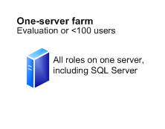
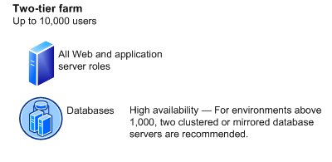
SharePoint 2010: Standard Architectures
Limited Deployments
One Server Farm
  Scenario: demonstrations / Proof-of-Concept only
  Production would be restricted to <100 users
  Will need a large amount of memory to perform well (16 GB)
Two Tier Farm
  Probably 5000+ users
  High Availability would require SQL Clustering or Mirroring

Slide 21
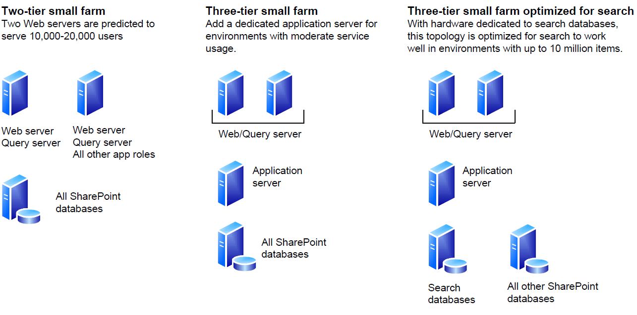

SharePoint 2010: Standard Architectures
Small Farm Topologies
Two-tier Small Farm
Three-Tier Small Farm
Three-Tier Optimized for Search

Slide 22
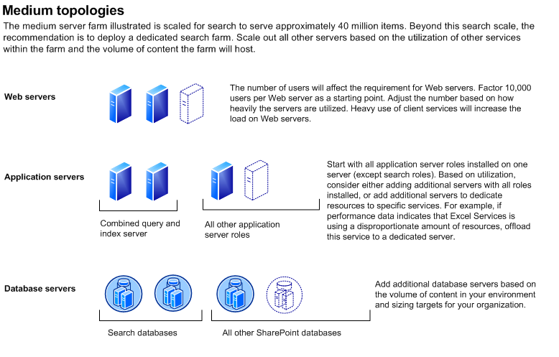
SharePoint 2010: Standard Architectures
Medium Farm Topologies
Medium Farm
  1-N WFEs / 1-N App Servers / 1 SQL Instance
Most common Enterprise configuration
Support 20-50k users (Probably – we’re still in Beta ☺ )

Slide 23
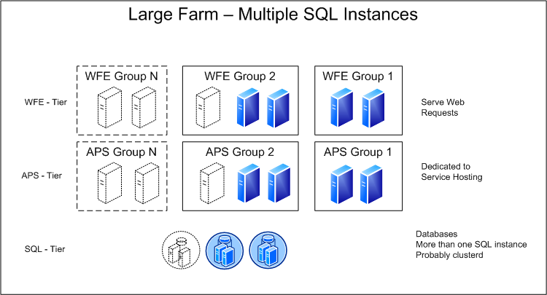
SharePoint 2010: Standard Architectures
Large Farm Topologies
Multiple SQL Instances
Large Farms can have multiple groups

Slide 24
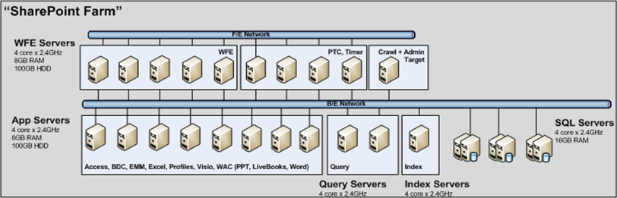
SharePoint 2010: Standard Architectures
Sample - Very Large Farm Design
3 Groups in Front Tier – 10 Servers
3 Groups in App Tier – 11 Servers
1 SQL Tier – 6 Servers

Slide 25
SharePoint 2010:
Search Topologies

Slide 26
SharePoint 2010: Search Concepts
Administration
  Administration component
  Administration database
Query
  Query component
  Index Partition
  Property Database
Crawl
  Crawl Component
  Crawl Database

Slide 27
SharePoint 2010: Search Topologies
Small Farm
Up to ~10 M Items
Web Server and Query Server on same boxes
2 index partitions,
1a active – 1b passive
Index server not redundant

Slide 28
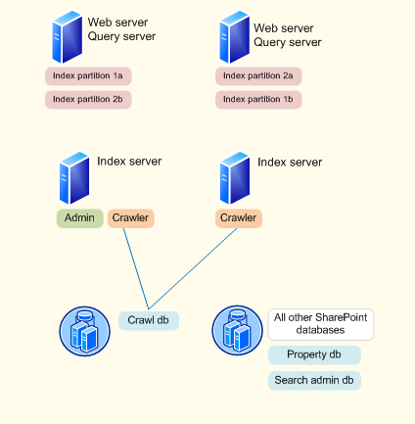
SharePoint 2010: Search Topologies
Medium Farm
Up to ~50 Million Items
2 index partitions (both redundant)
Redundant Indexer
1 Crawl Database
1 Property Database

Slide 29
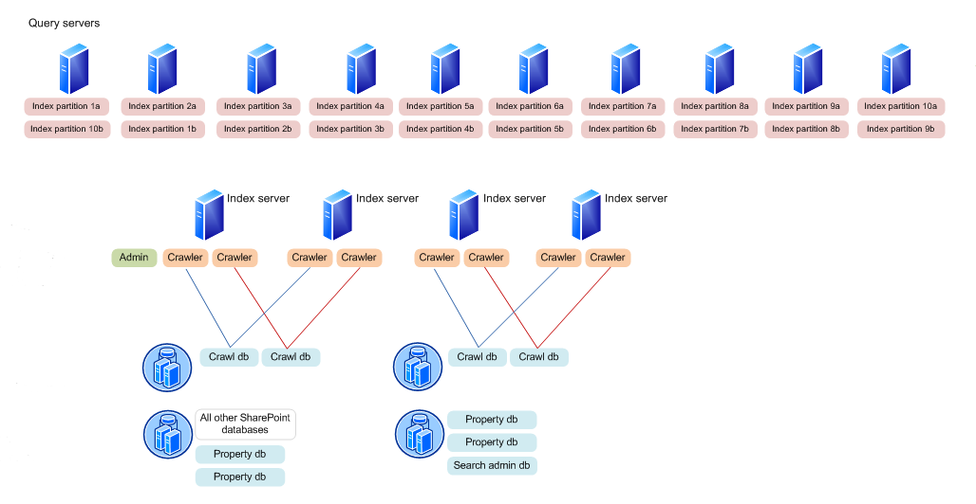
SharePoint 2010: Search Topologies
Medium / Large Farm
Up to 100 Million Items
10 Search Servers
All Crawlers Redundant

Slide 30
SharePoint 2010:
Service Application Architecture

Slide 31
SharePoint 2010: Service Applications
Application Model
SSP
User Profiles
Excel Calc
Search
User Profiles
Search
BDC
Excel Calc
BDC
Visio
WAC
3rd party Service
http://hrweb/
http://itweb/
http://hrweb/
http://itweb/
Corp Farm
Corp Farm
SharePoint 2007 Model
SharePoint 2010 Model

Slide 32




SharePoint 2010 Service Applications
Terms
Service: A set of bits installed on a farm that’s capable of providing some functionality
Service Application (SSA): A specific farm-level configuration of the Service in SharePoint
Service Application Proxy: A pointer to a Service App that exists on the WFE
Service Consumer: A SharePoint feature, such as a web-part, that talks with the service and makes its functionality available to an end user
Search
User Profiles
http://itweb
http://msweb

Slide 33
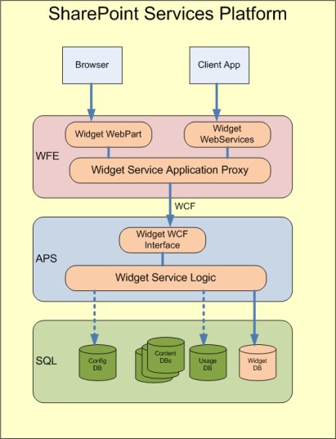
SharePoint 2010 Services Applications
Architecture
Custom Service Applications can be created using this architecture
Some components are mandatory, others optional
Windows Communications Framework (WCF) is strongly recommended
Supports remote consumption of services

Slide 34
SharePoint 2010 Service Applications
Managed via Central Administration
  No separate Web Application
Web applications consume services on an individual basis
  Each Web Application can use any combination of the
  available Service Applications
Deploy multiple instances of the same Service Application
  Just give each one a unique name
Share Service Application instances over many Web Applications in farm

Slide 35
SharePoint 2010 Services Applications
Framework
“Native” Service Applications built on it
  ISVs can build their own, as well
Built-in support for scaling applications
  Multi-Server support
  Fault Tolerant Round-Robin Load Balancer
Mechanisms to host and deploy Service Applications
  Timer Job Support
  PowerShell Support
Capability to be multi-tenant aware

Slide 36
SharePoint 2010 Services Applications
Benefits of a Shared Services Architecture
Simpler Administration experience
Organization governance from a single location
  Shared Services Architecture now allows a global company to consume from a ‘master’ farm
Now possible to enforce a company-wide taxonomy from a single location

Slide 37
SharePoint 2010 Service Applications
Native SSA’s (1 of 2)
Access Services
  Allows viewing, editing, and interacting with Access databases in a browser.
Business Data Catalog
  Allows integration with LOB applications (Lines-of-Business).
Excel Services
  Allows viewing and interactivity with Excel files in a browser.
Managed Metadata Service
  Provides access to managed taxonomy hierarchies, keywords, social tags and Content Type publishing across site collections.
People
  Enables creation and sharing of user profiles, organization profiles and social tags (required for MySite); depends on the Enterprise Metadata service and can share data with the Search service.
Search Service Application
  Index content and/or serve search queries.

Slide 38
SharePoint 2010 Service Applications
Native SSA’s (2 of 2)
Secure Store Service
  Provides capability to store data (e.g. credential set) securely and associate it to a specific identity or group of identities.
State Service
  Provides temporary storage of user session data for Office SharePoint Server components.
Usage and Health data collection
  This service collects farm wide usage and health data and provides the ability to view various usage and health reports.
Visio Graphics Service
  Enables viewing and refreshing of published Visio diagrams in a web browser.
Web Analytics Service Application
  Enable rich insights into web usage patterns by processing and analyzing web analytics data .
Word Conversion Service Application
  Provides a framework for performing automated document conversions

Slide 39
SharePoint 2010 Service Applications
Proxies
Proxy is the virtual link used to connect SharePoint Web Applications to Shared Service Applications
  Proxy created automatically when a Service Application is created
  Proxies are managed with Service Applications in Central Administration
  Some proxies might include settings which can be modified
  A single proxy can be used by multiple Web Applications

Slide 40
SharePoint 2010 Service Applications
‘Parent Farm’ (2007) vs. ‘Cross Farm’ (2010)
(2007) Parent Farm is ‘all or nothing’
  Configure 1 SSP to provide services to other farms
  Configure child Web Application to consume 1 SSP with ALL services from parent
  Child farm needs access to parent farm databases
(2010) Cross-Farm Service Applications are flexible
  Remote farms don’t need perms to parent farm databases
  Any farm can publish Shared Service Applications
  Web Application can use both local and remote Service Applications
  Provides for centralized “enterprise” services
  Not all Services can be shared between farms
    YES: People, Managed Metadata, BDC, Search, Secure Store, Web Analytics, PerformancePoint
    NO: Project, Excel Services, Access, Visio, Word, Word Viewing

Slide 41
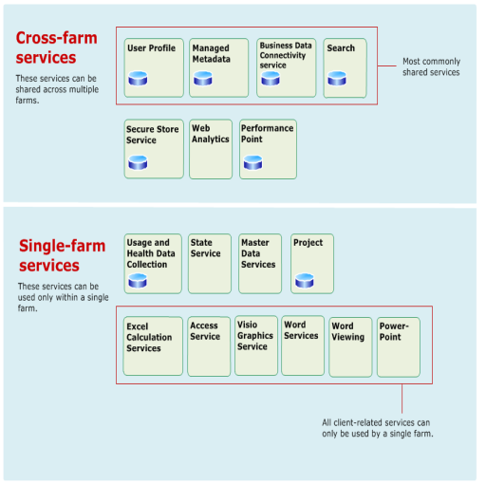
SharePoint 2010 Service Applications
Shared Services Architecture
(2010) Shared Services Architecture
  Formerly, ‘Shared Service Providers’
Example: ‘Cross-farm topology’
  Some services can be federated
  i.e. consumed from a remote farm

Slide 42
SharePoint 2010 Service Applications
Deploying Services Across Farms
Configure Trusted Farms
  Consuming farm must trust root Certificate Authority (CA) for SSL certificate on remote SharePoint Web Services (IIS) site
Publish Service Application
  Creates a URL for the Service Application
Connect to ‘Cross Farm’ Service Application
  Select the URL that was published (above)

Slide 43
SharePoint 2010 Service Applications
Simple Service Application Association

Slide 44
SharePoint 2010 Service Applications
Multiple Service Application Association

Slide 45
SharePoint 2010 Service Applications
‘Content-Only Farm’ consuming from ‘Enterprise Services Farm’

Slide 46
SharePoint 2010 Service Applications
Multiple Farms – Mixed Service Application Association

Slide 47
SharePoint 2010 Service Applications
Multiple Farms – ‘Multi-Enterprise Service Application Farms’

Slide 48
SharePoint 2010 Service Applications
Geographical Distribution
There is nothing built-in, specifically aimed at ‘Geo’ distribution of Service Applications
  However, some Service Applications are optimized to perform better over WAN
  All Service App communications take place over HTTP or TCP (WCF)
    Most Service Apps built on WCF
  No direct database access across farms
  Protocol optimized using binary streams instead of XML
    Note: Early Beta testing shows better throughput as a result

Slide 49
SharePoint 2010:
Other Headlines…
Multi-Tenancy
Hosting
Capacity Management
Health & Monitoring
Back-up & Restore
Deployment Enhancements
Virtualization

Slide 51
SharePoint 2010: Multi-Tenancy
“Unique deployment for each customer
on a shared set of resources”
Offer smaller sets of data and settings isolation within a single SharePoint Farm
2010: Every feature is inherently multi-tenant
  This includes Services (formerly the SSP) - which
  can be configured store data
  on a per-tenant basis
1
2
WA
SA
Tenant 1
Tenant 2
SC
SC
SC
SC
SC
SC
SC
SC
SC
SC

Slide 52
SharePoint 2010: Hosting
Scalable, Unified Infrastructure
Pervasive across entire platform
Many features will provide value inside a single organization as well as in multi-tenant deployments
  Central IT can host with business unit “tenants”
Notes
  “SharePoint” hosting today is almost exclusively WSS – this will change…
  SharePoint Online is Microsoft’s first and best customer, here

Slide 53
SharePoint 2010: Capacity Management
Do not think, ‘SharePoint Capacity Planning’…
Think SharePoint Capacity Management

Slide 54
SharePoint 2010 Performance & Capacity
From Beta to Launch
Product group are only now getting initial feedback on performance and capacity
  Do not yet know exactly where this will land – thus any numbers guidance is subject to change…
Product Group addressing Enterprise Readiness Issues around Capacity Management, Reliability, performance Throughput
  Testing in a very thorough fashion in SharePoint 2010
Large investments have been made in optimizing performance
  Giving developers and administrators the ability to develop performant systems and control and tune them
The end result of all of this should be a Enterprise Ready SharePoint
  Capable of handling much larger loads in a predicable and performant fashion

Slide 55
SharePoint 2010: Health & Monitoring
Areas of Investment
Diagnostics
Diagnostics
  Unified Logging Service (ULS)
  Logging Database
  Developer Dashboard
Reliability – Monitoring
  SharePoint Maintenance Engine (SPME) Rules
  System Center Operations Manager Monitoring
Reporting
  Out of box Usage Reports
  System Center Operations Manager Reports
Sustaining
Reporting
Monitoring

Slide 56
SharePoint 2010: Deployment Enhancements
Flexible Deployment
Simplified
  SharePoint preparation tool
    One-click tool to install pre-requisites
  Wizard-based initial deployment for farms
    Simplifies and speeds up configuration
Scriptable
  Initial installation, configuration and maintenance is scriptable through PowerShell
‘Block and Track’
  Group Policy, to block
  Active Directory Service Connection Point, to track

Slide 57
SharePoint 2010: ‘Backup & Restore’
Microsoft now support back-up of farm configuration settings
Former script-only capabilities are now available in the UI
  Includes exploring a site for backup/export
SQL Server Database snapshot support
  Improves backup integrity and availability
Restore from an unattached database enables…
  Restore from a snapshot
  Restore without a dedicated restore farm

Slide 58
SharePoint 2010: Virtualization
Virtualization completely supported for all tiers, but not necessarily recommended
There will be a performance hit to virtualize; baseline test in SharePoint 2007 were 7-11%
  Latest MS Tests show performance hit of 10-20%...but your mileage may very
Virtualization most interesting for small and medium deployments and supporting farms, POCs, and Development
Server Virtualization Validation Program lists supported platforms:
http://www.windowsservercatalog.com/svvp.aspx

